Slide 1


Machine Learning Application for Healthcare

Slide 2
Egyptian E-Learning University
2024/2025
Discussion with:
Dr. Rodaina Abdelsalam
Dr. Mayar Ali

Slide 3
Supervisors :
Eng/Sabah Morsy
Prof/ Walaa Elhady
)Professional assistant in EELU(
) Assistant Lecturer in EELU(

Slide 4

Team Members:
John Karam William
Tadros Ashraf Malak
Areeg Aboelhamd Ali
Selvana Raeef Youssef
Mariam Sameh Shafeek
Moreen Ayman Aziz
Mayar Abdelraheem

Slide 5
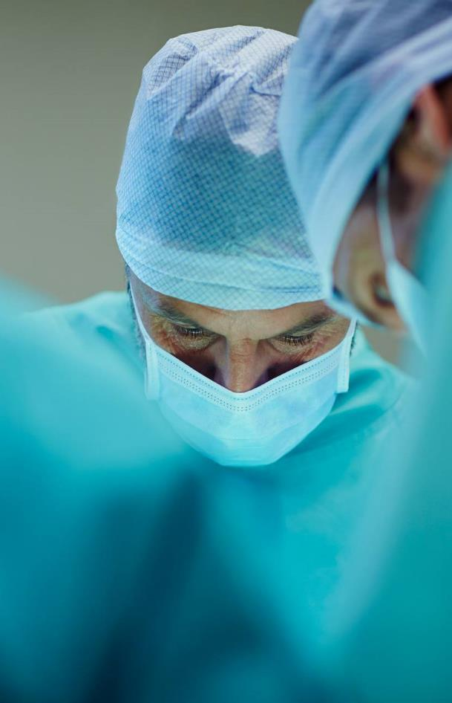

Outlines
Introduction
Problem Definitions
Motivation
Related Applications
Related Work
Software Requirement
Use Case Diagram
Proposed Solution
Application life cycle
Dataset
Technology Used
Demo
Final Results
Future work

Slide 6



Introduction
Role of Technology in Early Skin Cancer Detection:
Exploring how technology plays a vital role in detecting skin cancer at an early stage.
Skin Cancer Statistics:
According to the World Health Organization (WHO), skin cancer is the most prevalent among all cancer types.
Approximately 5,4 million new cases of skin cancer are reported annually.
Skin as the Largest Organ:
This provides an opportunity for cancer to grow and spread rapidly if not detected early.

Slide 7

Problem Definitions:
Late diagnosis of skin cancer may make it more difficult to treat.
Traditional methods of diagnosing skin cancers can be painful and expensive
Some patients can have difficulty accessing specialized health care for a skin cancer diagnosis.

Slide 8
Problem Definitions(Cont.)
Physicians face the challenge of differentiating benign tumors from malignant tumors.
Manual diagnosis of skin cancer can be vulnerable to human error.

Slide 9
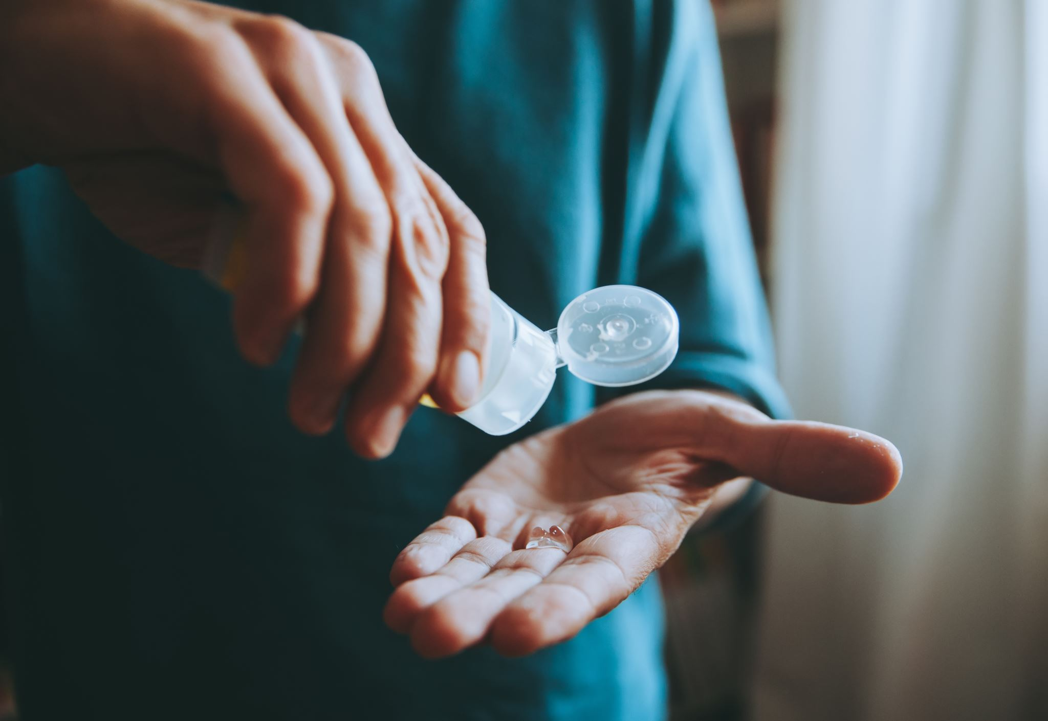
Motivation
Increased chances of cure when skin cancer is
detected in its early stages, the chances of cure
are much higher.

Slide 10




Related Application
Advantages
Disadvantages
- It can be used to examine the entire body.
- Not easy to use.
Mole Scope
- Provides information about moles and skin spots.
- It cannot identify types of skin cancer other than just melanoma.
Miiskin
-Provides an instant risk assessment for skin cancer after analyzing the image .
-It may only be available in some regions
SkinVision
- Provides an extensive database of medical images.
- Subscribing can be expensive.
VisualDx

Slide 11
Relatedwork
Research Title | Researcher Name | The Module and the Algorithm used | Year | Accuracy
State-of-the-art machine learning techniques for melanoma skin cancer detection and classification: a comprehensive review. | Harsh Bhatt, Vrunda Shah | CNN SVM KNN | 2023 | %97.70 96.90% 95.32%
A comprehensive study on skin cancer detection using artificial neural network (ANN) and convolutional neural network (CNN). | A.Shah, A.Pandyaetal | CNN ANN | 2023 | 92% 86.3%
Skin cancer classification using explainable artificial intelligence on pre-extracted image features. | Kumar & Vatsa | CNN KNN ANN | 2022 | 89.6% 85.7% 83.2%

Slide 12

Functional Requirements:
Image Capture
Disease Identification
Determine whether the disease is malignant or benign
Information about types of skin cancer
Medication schedule reminder
Result Display
Arabic and English language

Slide 13
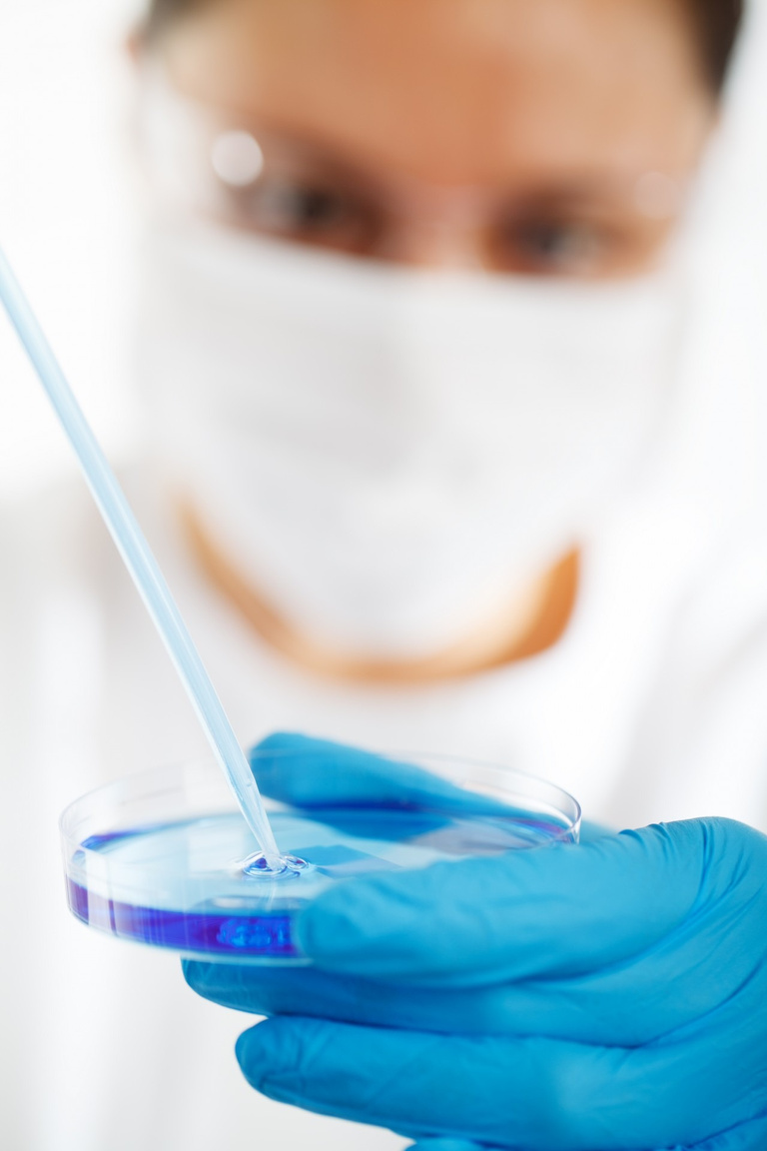
Non-Functional Requirements:
Performance
Scalability
Compatibility
Ease of Use
Reliability
Privacy and Data Retention

Slide 14


Use Case Diagram
Verify
password
>> Include <<
login
Detect the type of skin tumor
>> extend <<
Display Login Error
>> Include <<
Take photo of injerd skin
Object
Detect bemimg tumors
Detect milignsnts tumors
Pdate my profile
User
Provide medical information about different typs of skin tumors
Change account password
Reminder of medication appointments
Setting dates and nimber of medication doses
>> Include <<
Log out

Slide 15

Proposed Solution
Treating skin cancer is more difficult because it is not detected early, so we decided to create an application that helps people detect the disease early.
Through photographing the sample , it will identify it and determine the name of the skin cancer

Slide 16
Proposed Solution(Cont.)
It is possible to misdiagnose the disease, so we have provided the application to help people know and confirm the type of tumor
Provide the most important information about each disease and itis free for all patients.
Remember to take medication schedules Adhering to medication schedules is crucial to your health and well-being

Slide 17
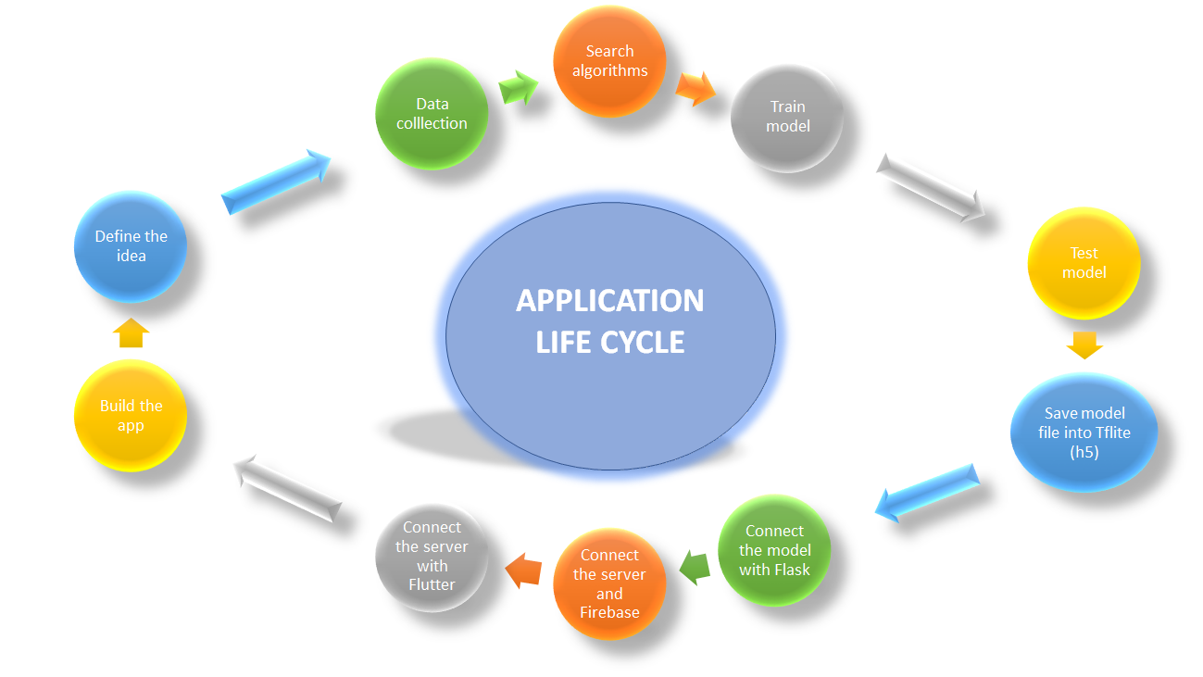

Slide 18
Dataset :
Dataset contains : (13000) row
Dataset contains : (10) classes
Data is contain into 10 types of skin cancer
I use the same data We divided it into 2 classes
Melanocytic Nevi(nv)
Melanoma. (mel)
benign keratosis.(bkl)
basal cell carcinoma(bcc)
vascular lesions (vl)
Actinic keratoses (AK) Dermatofibroma (Derm)
Squamous Cell Carcinoma(scc)
Mycosis Fungoides(mf)
Object
Malignant cancer
Benign cancer
contains 5 classes
Mel
bcc
Ak
scc
mf
contains 4 classes
nv
bkl
Derm
vl
Reviewed by: Dr/ Ehab Mohamed Mounir

Slide 19







Technology Used

Slide 20

Demo

Slide 21

Final Results
The application helps diagnose and classify skin diseases based on the input images with an accuracy of up to 98.6%..
The application help people know and confirm the type of disease with accuracy 99.4%.
The application will provide patients with information about their skin cancer diseases.
The application will provide patients with medication schedule reminder.

Slide 22
Future Work
1- Adding new languages and to expand the reach of the application to a wider patients.
2-Integrating the application with other technologies such as augmented reality and virtual assistants to further enhance the functionality and usability.

Slide 23
Future Work(Cont.)
3-Using user feedback and testing to identify areas for improvement and help guide the
development of new features and improvements to existing ones.
4-Integration of Deep Learning Models: Expanding the project's capabilities by integrating
more advanced deep learning models could lead to improved disease detection accuracy.

Slide 24
Reference
Bhatt, Harsh, et al. "State-of-the-art machine learning techniques for melanoma skin cancer detection and classification: A comprehensive review." Intelligent Medicine 3.03 (2023): 180-190.‏
Shah, Aarushi, et al. "A comprehensive study on skin cancer detection using artificial neural network (ANN) and convolutional neural network (CNN)." Clinical eHealth (2023).‏
Khater, Tarek, et al. "Skin cancer classification using explainable artificial intelligence on pre-extracted image features." Intelligent Systems with Applications 20 (2022): 200275.‏
Dataset
https://www.kaggle.com/datasets/kmader/skin-cancer-mnist-ham10000
Sample Footer Text
24

Slide 25
Reference(Cont.)
APPS
https://play.google.com/store/apps/details?id=com.molescope
2. https://play.google.com/store/apps/details?id=com.miiskin.android
3. https://play.google.com/store/apps/details?id=com.rubytribe.skinvision.ac
4. https://play.google.com/store/apps/details?id=com.visualdx

Slide 26
Reference(Cont.)
Diseases
1.https://www.mayoclinic.org/diseases-conditions/melanoma/symptoms-causes/syc-20374884
2. https://en.wikipedia.org/wiki/Melanocytic_nevus
3.https://www.mayoclinic.org/diseases-conditions/basal-cell-carcinoma/symptoms-causes/syc-20354187
4. https://www.mayoclinic.org/diseases-conditions/seborrheic-keratosis/symptoms-causes/syc-20353878
5.https://www.mayoclinic.org/diseases-conditions/actinic-keratosis/symptoms-causes/syc-20354969

Slide 27
Reference(Cont.)
Diseases
6. https://en.wikipedia.org/wiki/Dermatofibroma
7. https://www.healthline.com/health/pyogenic-granuloma
8. https://my.clevelandclinic.org/health/diseases/17480-squamous-cell-carcinoma
9. https://my.clevelandclinic.org/health/diseases/21827-mycosis-fungoides
Sample Footer Text
27

Slide 28

Thank you

